Slide 1
COMP 51 Week Fourteen
Recursion

Slide 2
Learning Objectives
Recursion
Understand how functions can invoke themselves
New programming control structure and design model

Slide 3
Why Do We Care
User the power of Recursive programming!
Introduction to algorithm design
Solve common programming problems

Slide 4
To Dream within a Dream
Inception Trailer
http://www.youtube.com/watch?v=66TuSJo4dZM

Slide 5
Recursion – Simply Explained
Function Calls itself
Int myRecursive(int testValue) {
If (testValue == 0)
Return something
Do some calculation
testValue--;
return(myRecursive(testValue));
}
Example
Factorial(n) = n*(n-1)*(n-2)*…*1
Factorial(4) = 24
The test does not have to be zero. It can be any ending condition
This is the recursive call!

Slide 6
Factorial Revisited - Loop
Cout << “Enter a factorial amount”
Cin >> num
Fact = 1;
For (i = num; i > 0; i--)
Fact = fact * i;

Slide 7
Factorial Recursive Solution
Termination condition (base case)
int factorial(int n) {
if (n == 0)
return 1;
else
return (n * factorial(n-1));
}
Recursive call with changed argument
Combining Step

Slide 8

Steps to Write Recursive Functions
Identify the base case (the if statement)
Determined what this result should be
Define the call so as to make the problem smaller → closer to the base case. (toughest part!)
Interactive Animation

Slide 9

Fibonacci Example
What is the base case __________
What is the base result __________
What is the function call __________
Notes:
http://talkbinary.com/programming/c/recursion-examples/

Slide 10
Recursion Location
Option One – At end of function
Calculation is done first
Result is assigned to the recursive call
Option Two – near top of function
Calls burrow down to the base case.
Result is combined via return statement
Goal is to cast the problem as a choice to be made.

Slide 11
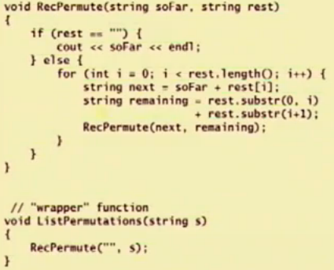
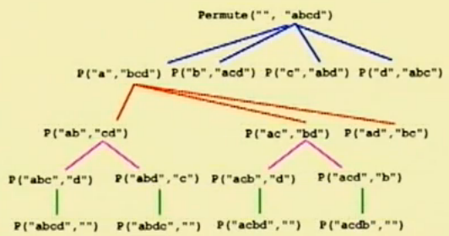
Permutation Problems Very Common Programming Issue

Slide 12
Subset Problems Another Common Pattern
Find all subsets of some input (typically a string)
“abc” has subsets “a”, “b”, “ab”, “ac”,…
Order does not matter → “ab” = “ba”
Solution
Separate element from string. Use first.
Form subsets that include the element
Then form subsets without the element
Base Case = When subset is null

Slide 13
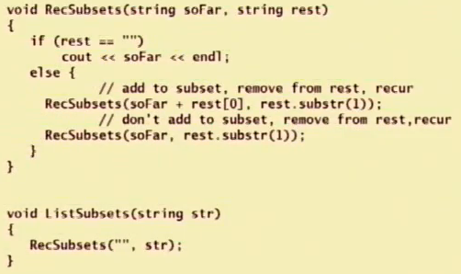
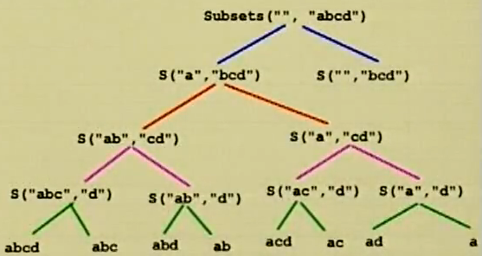
Subset Recursive Code
Two recursive calls in the function

Slide 14
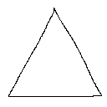
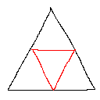
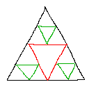
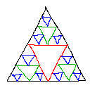
Fractal Graphics Sierpinski Triangle – Recursion Example
Start with single triangle
Draw an upside down triangle
Draw three smaller triangles in the resulting upwards triangle
Repeat with the 9 upwards triangles

Slide 15
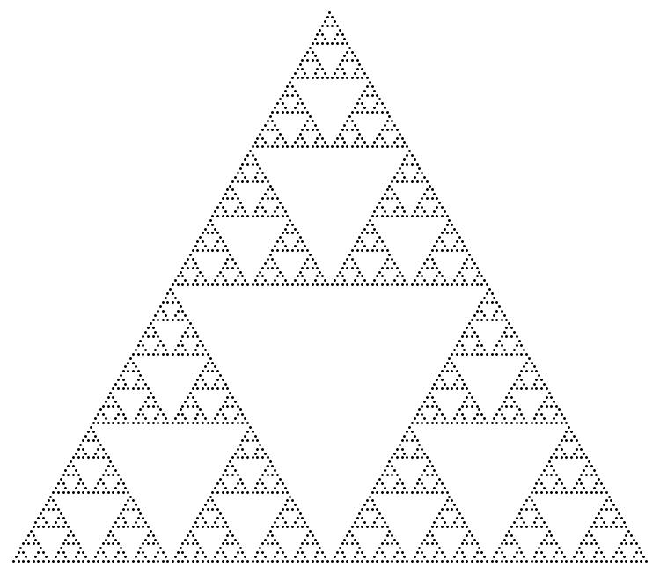
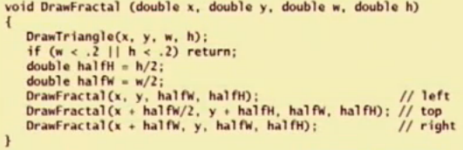
Final Fractal Graphic

Slide 16
Recursion Processing Sequence
Fractal
Top
Right
Left
L-Left
L-Top
L-Right
L-L-Left
L-L-Top
Base

Slide 17
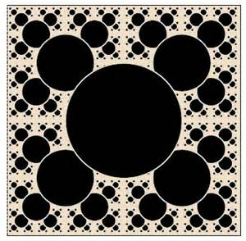
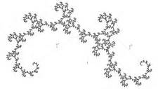
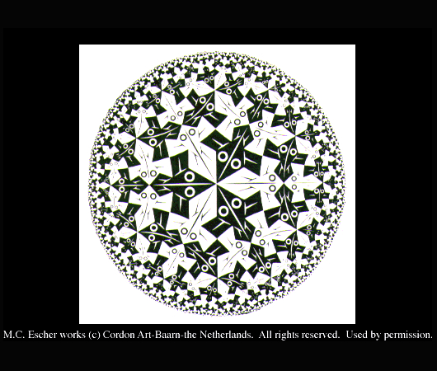
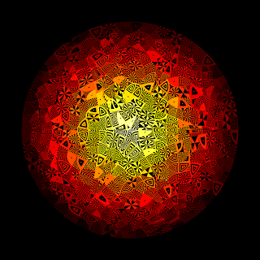
Other Fractal Examples

Slide 18
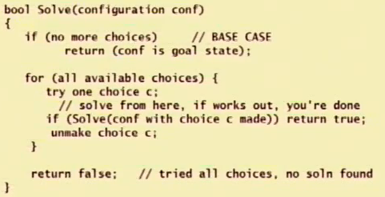
Backtracking Pseudocode
During game play (such as Chess), you need to undo a poor choice

Slide 19
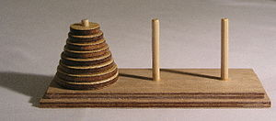
Tower of Hanoi Classic Recursive Solution
Rules of Game
Three towers
Goal is to move discs from one tower to another tower
Move only one disk at a time
Can not move bigger disk on top of smaller disk
Here’s the Solution
http://en.wikipedia.org/wiki/File:Tower_of_Hanoi_4.gif

Slide 20
Iterative Tower Solution
For an even number of disks:
make the legal move between pegs A and B
make the legal move between pegs A and C
make the legal move between pegs B and C
repeat until complete
For an odd number of disks:
make the legal move between pegs A and C
make the legal move between pegs A and B
make the legal move between pegs B and C
repeat until complete

Slide 21
Tower Practice
Pseudocode
function hanoi is: input: integer n, such that n >= 1 1. if n is 1 then return 1 2. return [2 * [call hanoi(n-1)] + 1] end hanoi
Steps
Function prototype : void tower(int n,char from,char aux,char to);
Base case : if (n == 1)
Print "\t\tMove disc 1 from "<<from<<" to "<<to
Otherwise, call tower twice but switch from, aux, to in each call
Print out the move between the calls
Main program
Prompt user for number of discs
Initial call is tower(num,'A','B','C');

Slide 22
Key Takeaways
Recursion
Just as confusing as the movie Inception!
Powerful programming model
Can be expensive from a RAM memory usage.
The Inception Kick
http://www.youtube.com/watch?v=3A1pIRXPCL8

